Slide 1
Finite State Machine Or Finite Automata
Module 1

Slide 2
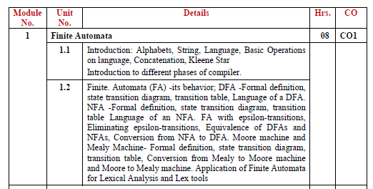
Syllabus

Slide 3
Computational models
CMs
Real computers are quite complicated to allow us to set up a manageable mathematical theory for them directly
Instead we can use an idealized computer called computational model in order to begin the theory of computation

Slide 4
Finite automata
The simplest computational model is called a finite state machine or a finite automaton
FA are good models for computers with an extremely limited amount of memory

Slide 5
Finite automata
Before developing the mathematics of finite automata we will examine the usage of a concrete finite automaton:
The controller of an automatic door

Slide 6
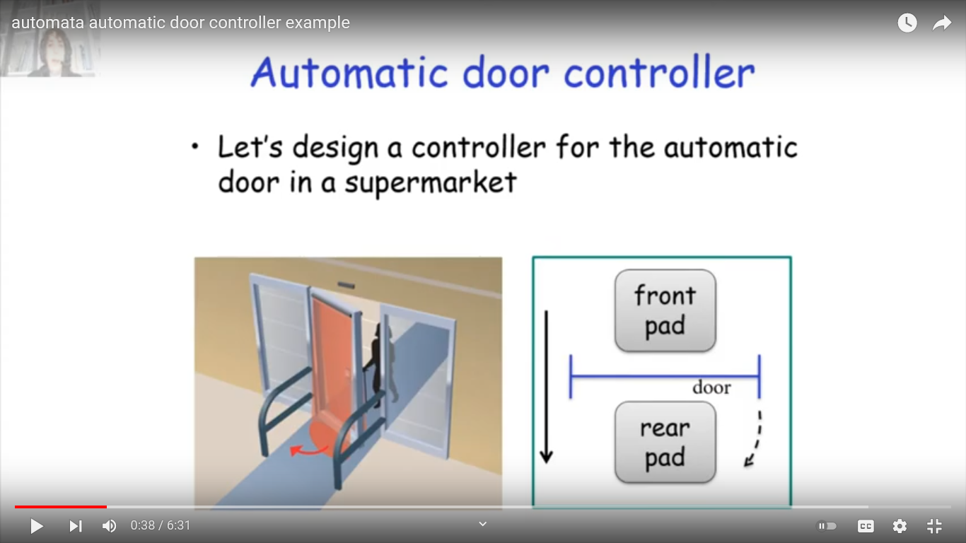
The controller of an automatic door
Automatic doors are often found at supermarket entrances and exits
An automatic door swing open when sensing that a person is approaching

Slide 7
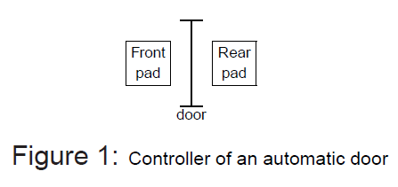
The controller of an automatic door
An automatic door is controlled by a simple automaton seen in Figure 1
One way door

Slide 8
Behaviour
An automatic door has a pad in front to detect the presence of a person about to walk through the door
Another pad is located to the rear of the doorway so that the controller can hold the door open long enough for the person to pass all the way through

Slide 9
States of the controller
The controller is in either of two states:
open or closed
representing the condition of the door
There are 4 possible input conditions:
front, meaning that a person is standing on the front pad
rear, meaning that a person is standing on the rear pad
both, meaning that people are standing on both pads
neither, meaning that no one is standing on either pad
Inputs to the controller

Slide 10
Interpretation
When controller is in the state closed and the input is REAR or NEITHER the controller remains in the state closed.
In addition, If the input BOTH is received, it stays closed because opening the door risks knocking someone over the rear pad. But if input FRONT arrives, it moves to the open state

Slide 11
Interpretation
When controller is in the state closed and the input is front the controller moves to the state open

Slide 12
Interpretation
When the controller is in the state open
Input is one of front, rear, both, the controller remains in the state open
When the controller is in the state open
Input is neither the controller moves to the state closed

Slide 13
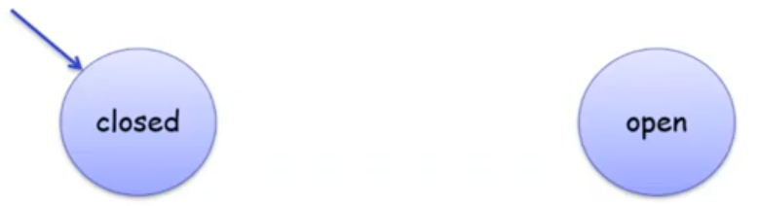
State transition diagram
Depicts the movements of the controller from state to state depending upon the input it receives
Start State=Closed

Slide 14
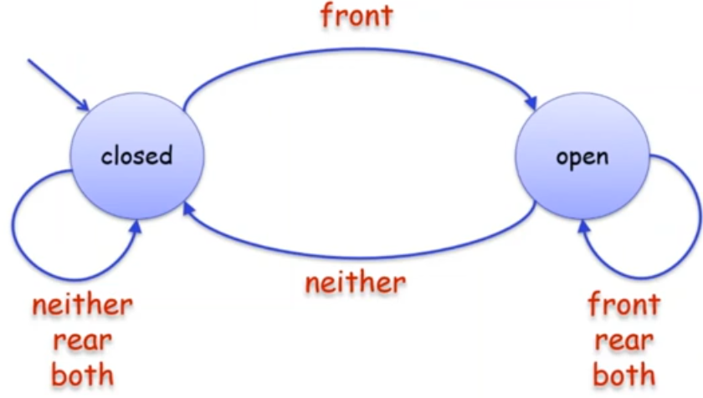
State transition diagram
The state transition diagram of the controller,

Slide 15
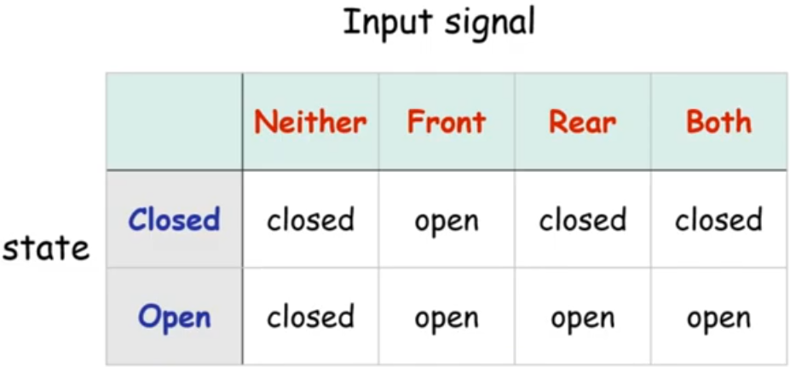
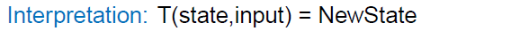
State transition table
The movement of the controller (and of the door) can also be represented by a table
Rows are labelled by the states
Columns are labeled by the input

Slide 16
Exercise
How should we change the state diagram if we have a sliding door?
Try it Out!!

Slide 17
This controller is a computer that has just a single bit of memory capable of recording the two states of the controller.
Other common devices have larger memories.

Slide 18
Examples
Other similar devices need controllers with larger memory.
??

Slide 19
Examples
Example-
A state of the controller of an elevator may represent the floor the elevator is on and the inputs may be signals received from other floors

Slide 20
Examples of FSM
Example-
Controllers of various household appliances such as
dishwashers,
electronic thermostats ,
parts of digital watches,
calculators
are computers with limited memories.

Slide 21
Examples of FSM
A switching circuit, such as the control unit of a computer.
A switching circuit is composed of a finite number of gates, each of which can be in one of two conditions, usually denoted 0 and 1.
The state of a switching network with n gates is thus any one of the 2^{n} assignments of 0 or 1 to the various gates

Slide 22
Examples of FSM
Although the voltages on each gate can assume any of an infinite set of values, the electronic circuits are so designed that only two of the voltages corresponding to 0 and 1 are stable and other voltages instantaneously adjust themselves to one of these voltages.
Thus, It a FSM that separated the logical design of a computer from the electronic implementation

Slide 23
Design a FSM for JK Flip Flop

Slide 24
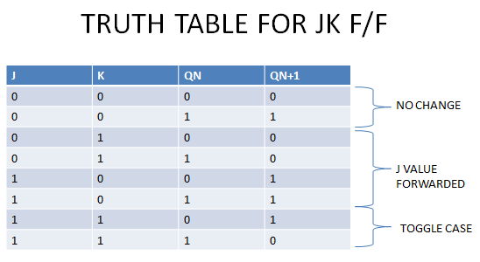
FSM for JK Flip Flop

Slide 25
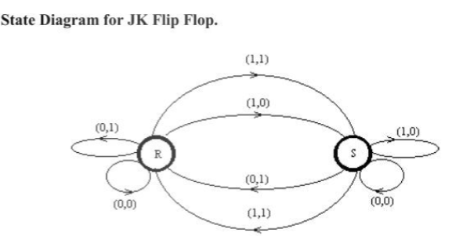
FSM for JK Flip Flop

Slide 26
Examples of FSM
Certain commonly used programs such as text editors and the lexical analyzers found in most compliers are often designed as finite state systems.

Slide 27
Examples of FSM
For example, a lexical analyzer scans the symbols of a computer program to locate the strings of characters corresponding to
identifiers,
numerical constants,
reserved words, and so on.
In this process the lexical analyzer needs to remember only a finite amount of information,
such as how long a prefix of a reserved word it has seen since startup.

Slide 28


Wolf, Goat, and Cabbage problem
A man with a wolf, goat, and cabbage is on the left bank of a river.
There is a boat large enough to carry the man and only one of the other three.
The man and his entourage wish to cross to the right bank, and the man can ferry each across, one at a time.

Slide 29
Wolf, Goat, and Cabbage problem
If the man leaves the wolf and goat unattended on either shore, the wolf will surely eat the goat.
If the goat and cabbage are left unattended, the goat will eat the cabbage.
Is it possible to cross the river without the goat or cabbage being eaten?

Slide 30
Wolf, Goat, and Cabbage problem
The problem is modelled by observing the occupants of each bank after a crossing.
There are 16 subsets of the man (M), wolf (W), goat (G), and cabbage (C).

Slide 31
Wolf, Goat, and Cabbage problem
States are labelled by hyphenated pairs
Left Bank Occupants-Right Bank Occupants
Symbols on left of the hyphen=subset on the left bank
Symbols on right of the hyphen=subset on the right bank
Eg: MG-WC

Slide 32
Wolf, Goat, and Cabbage problem
Fatal Combination-
GC-MW
GW-MC
These are fatal and may never be entered by the system

Slide 33
Wolf, Goat, and Cabbage problem
The inputs are the action that the man takes
Man crosses alone=Input m
Man crosses with wolf=w
Man crosses with goat=g
Man crosses with cabbage=c
Initial state=MWGC-ø
Final state=ø-MWGC

Slide 34
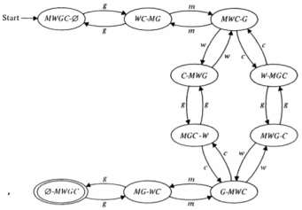
Wolf, Goat, and Cabbage problem
State Transition Diagram-
Showing all legal moves
All reachable states
Start state and Final state

Slide 35
Wolf, Goat, and Cabbage problem
There are two equally short solutions to the problem, as can be seen by searching for paths form the initial state to the final state.

Slide 36
Wolf, Goat, and Cabbage problem
Then a sequence of moves is a string,
Such as the solution gmwgcmg and gmcgwmg

Slide 37
Wolf, Goat, and Cabbage problem
What happens if we try a string that is not in the language?
Consider gmwm…we get stuck
with nowhere to go.

Slide 38
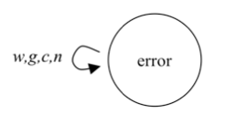
Wolf, Goat, and Cabbage problem
On many strings that are not solutions, the previous diagram gets stuck
Automata that never get stuck are easier to work with
We'll need one additional state to use when an error has been found in a solution

Slide 39
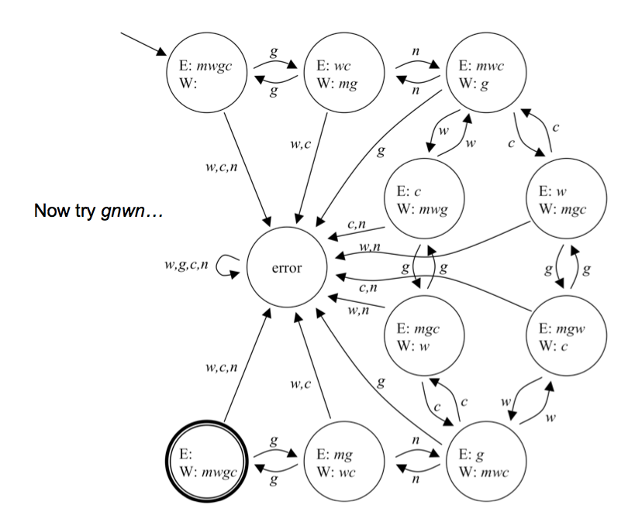
Wolf, Goat, and Cabbage problem
Here n=m

Slide 40
Set
A group of objects represented as a unit
Set may contain any type of object-numbers/symbols/other sets
-Michael Sipser

Slide 41
Set
Well defined Collection of Objects and denoted as-
Enumerating the member within { and }
Eg-A={0,1,2}
2) Using a set builder notation as:
A={x| p(x)}
A is set of all those x for which the predicate p(x) is true
Eg- A set of all integers divisible by 3
A={x| x is an integer and xmod3=0}
-Dr O.J Kakde

Slide 42
Alphabets
An alphabet is a finite, non empty set of symbols
Symbol for Alphabet= ∑
∑={0, 1} , the binary alphabet, probably the most important alphabet in computer science.
∑={a, b, c, ..., z}, The set of all lowercase letters
-Hopcraft

Slide 43
Strings
Strings-
A finite sequence of symbols chosen from some Alphabet
Eg- 01101 is a string from ∑={0, 1} , the binary alphabet
Empty String-
String with zero occurrences of symbols
Denoted by ε
A string that may be chosen from any alphabet whatsoever.
-Hopcraft

Slide 44
Strings
Length of a String-
Number of positions of symbols
Eg- 01101 has length 5,
5 positions for symbols
But no of symbols are only 2, i.e. 0 and 1
Denoted as |w|
|011|=3
| ε|=0
-Hopcraft

Slide 45
Strings
Concatenation of Strings-
Let x and y be strings
xy =Concatenation of x and y
String formed by copy of x and following it by a copy of y
If x=a1a2……ai
If y=b1b2…..bj
xy=a1a2….aib1b2….bj where length of string is i+j
-Hopcraft

Slide 46
Strings
Powers of an alphabet:
∑ is an alphabet ,
We can express the set of all strings of a certain length from that alphabet by using an exponential notation
∑^{k}=set of strings of length k, each of whose symbol is in ∑
∑⁰= ε, no matter what alphabet is in it, ε is the only string of length 0
-Hopcraft

Slide 47
Strings
Powers of an alphabet:
If ∑={a,b,c} then
∑¹={a,b,c}
∑²={aa,ab,ac,ba,bb,bc,ca,cb,cc} and so on
Difference between ∑and ∑¹
∑=alphabet with members a,b,c as symbols
∑¹=set of strings with members as the strings a,b and c of length 1
-Hopcraft

Slide 48
Strings
Powers of an alphabet:
∑* =Set of all strings over an alphabet ∑
∑* = Σ⁰ U Σ¹ U Σ² U ….
Excluding Empty String ε, as Σ⁰= ε
∑⁺ = Σ¹ U Σ² U Σ³ U ….
∑* = Σ+ U {ε}
-Hopcraft

Slide 49
Language
Set of string formed by using the symbols belonging to some particularly chosen alphabet
Common languages can be viewed as a set of strings
-Hopcraft

Slide 50
Language
English Language , the collection of legal English words is a set of strings over the alphabet that consists of all the letters
C or any other programming Language, where the legal programs are a subset of the possible strings that can be formed from the alphabet of the language.
The alphabet is a subset of the ASCII characters-generally uppercase lower case letters,digits,punctuation and mathematical symbols.
-Hopcraft

Slide 51
Language
Some abstract examples-
The set of strings of 0s and 1s with an equal no of each-
{ε,01,10,0011,0101,1001,…..}
The set of binary numbers whose value is prime:
{10,11,101,111,1011,…..}
Set Former Notation-
{w|w consists of an equal number of 0s and 1s}
{w|w is a binary integer that is prime}
-Hopcraft

Slide 52
Operation on Languages
Union-
Union of Two Languages L & M,
Denoted as L U M
The set of strings that are either L or M or both
Eg-If L={001,10,111}, M={ε,001}
L U M ={ε,10,001,111}
-Hopcraft

Slide 53
Operation on Languages
Concatenation-
Concatenation of Languages L and M
The set of strings that can be formed by taking any string in L and concatenating it with any string in M
Eg-If L={001,10,111}, M={ε,001}
L.M=LM={001,10,111,001001,10001,111001}
-Hopcraft

Slide 54
Finite Automata:
FA is the mathematical model (or formalism) of an FSM
The finite automaton is a mathematical model of a system, with discrete inputs and outputs.
Mathematical Models are abstractions and simplifications of how certain machines actually work
Help us understand specific properties of these machines

Slide 55
Finite Automata:
The system can be in any one of a finite number of internal configurations or "states".
The state of the system summarizes the information concerning past inputs that is needed to determine the behaviour of the system on subsequent inputs

Slide 56
Finite Automata: Formal Definition
A list of five elements is called a 5-tuple,
A finite automaton can be defined as a 5-tuple

Slide 57
Finite Automata: Formal Definition
FA is denoted by 5 Tuple:

Slide 58
Finite Automata: Formal Definition
FA is denoted by 5 Tuple: M=(Q, ∑, δ, q₀, F) where
Q:Finite set of states
∑:Finite input alphabet
δ:Q X ∑ ->Q State Transition function(STF)
q₀: Initial/Start state of FA, q0 ∈ Q
F: Set of Final States/ Accept State, F ⊆ Q

Slide 59
Finite Automata: Formal Definition
FA is denoted by 5 Tuple: M=(Q, ∑, δ, q₀, F) where
This definition is for Deterministic FA or DFA
The Transition Function for Non- Deterministic FA or NDFA is different
NDFA will be discussed later

Slide 60
State Transition function(STF)
Denoted by δ
Define rules of moving
We can denote the transition rules by a function called the transition function,
δ : States × Alphabet → States

Slide 61
State Transition function(STF)
If the FA has an arrow from a state x to state y labelled with input symbol 1
If Automaton is in state x, when it reads 1, it then moves to state y
δ(x,1)=y
Example: δ(q0, x) = q1

Slide 62
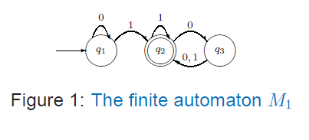
Machine M1
A FSM M1, that has 3 states, defined by the transition diagram in the figure 1

Slide 63
Machine M1
5 Tuple:-

Slide 64
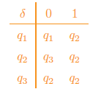
Formalizing M1
M1 = (Q, ∑, δ, q1, F) where
1. Q = {q1, q2, q3}
2. ∑ = {0, 1}
3. δ is described by the table:
4. q1 is the start state,
5. F = {q2}

Slide 65
Acceptor/Rejector
Upon reading the entire input string,
If the machine resides in any of the final states then the input string is “Accepted” by the Machine
If the machine resides in any of the non-final states then the input string is “Rejected” by the Machine
FA acts as an Input Acceptor or Rejector

Slide 66
Language of a DFA
If A is the set of all strings that a machine M accepts,
We say that A is the language of the machine M and write L(M) = A.

Slide 67
Terminology
In order to avoid confusion:
Use accept when we refer to strings
Use recognize when we refer to languages

Slide 68
Language of a DFA
A machine may accept several strings, but it always recognizes only one language
If a machine accepts no strings, it still recognizes one language, namely the empty language ∅

Slide 69
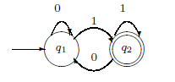
Machine M2
The state diagram in Figure 2 describes a machine M2
Write the 5 Tuple representation
Try finding the language of the string

Slide 70
Machine M2
5-Tuple Representation
M2 = ({q1, q2}, {0, 1}, δ, q1, {q2}) where
δ(q1, 0) = q1, δ(q1, 1) = q2, δ(q2, 0) = q1, δ(q2, 1) = q2

Slide 71
Machine M2-Acceptor/Rejector
A good way of understanding any machine is to try it on some sample input string

Slide 72
Machine M2-Acceptor/Rejector
String “1101”-Accepted/Rejected?

Slide 73
Machine M2-Acceptor/Rejector
String “1101”
Machine M2 starts in q1
From q1,reads 1=>q2
From q2 reads 1=>q2
From q2 reads 0=>q1
From q1 reads 1=>q2
String ends here and q2 is Final state
String is Accepted

Slide 74
Machine M2-Acceptor/Rejector
String “110”-Accepted/Rejected?

Slide 75
Machine M2-Acceptor/Rejector
String “110”
Machine M2 starts in q1
From q1,reads 1=>q2
From q2 reads 1=>q2
From q2 reads 0=>q1
String ends here and q1 is Non-Final state
String is Rejected

Slide 76
Language of DFA M2
L(M2) = {w| w ends in a 1}
M2 accepts all strings that end in a 1

Slide 77
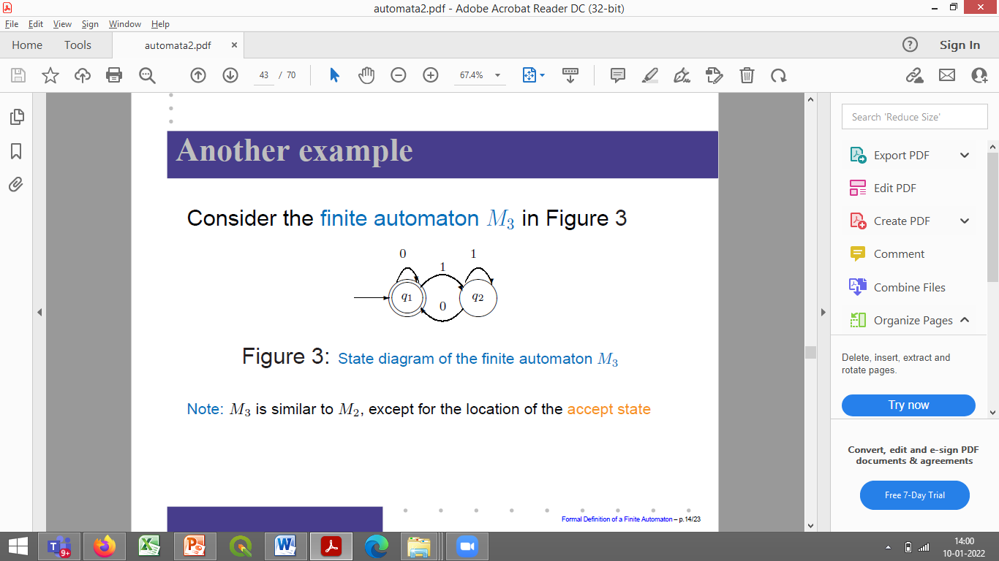
Machine M3
Consider the finite automaton M3 in Figure 3
M3 is similar to M2, except for the location of the accept state
Start state is also an accept state

Slide 78
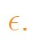
Machine M3-Acceptor/Rejector
As usual, M3 accepts all strings that leave it in an accept state when it has consumed the input.
M3 also accepts the empty string
As soon as M3 begins the reading of it is at the end,
So if Start state is an Accept state, it accepts it

Slide 79
Language of DFA M3
M3 also accepts any string ending with a Zero
L(M3) = {w|w is the empty string or ends in 0}

Slide 80
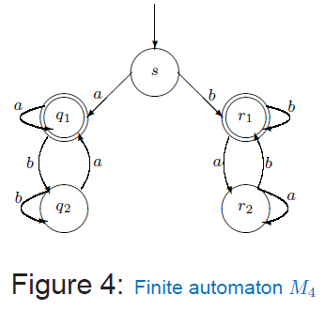
Machine M4
Consider the five-state machine M4, Figure 4

Slide 81
Machine M4-Acceptor/Rejector
M4 has two accept states, q1 and r1
M4 operates over the alphabet ∑ = {a, b}

Slide 82
Language of DFA M4
M4 begins in state s and after it reads the first symbol in the input it either goes to the left to q states or to the right to r states
Once M4 goes to the left or to the right,it can never return to the start state

Slide 83
Language of DFA M4
Strings-
a?
aa?
ab ?
aba ?
abbab ?
b?
bb?
ba?
bab?
baaa?
baabb?

Slide 84
Language of DFA M4
Some experimentation with M4 shows that -
Accepts strings as a, b, aa, bb, bab
Does not accept strings as ab, ba, bbba

Slide 85
Language of DFA M4
If the first symbol in the string is a then it goes to the left and accepts when the strings ends with an a
If the first symbol in the string is b then it goes to the right and accept when the strings ends with a b

Slide 86
Language of DFA M4
Accepts all strings that start and end with a or that starts and ends in b
Conclusion: L(M4) = {w|w = axa} ∪ {w|w = byb} for x, y ∈ ∑*

Slide 87
Exercise1 – Acceptor/Rejector
Consider the transition table given below and check whether the string ‘110101’ lies in L(M) or not. Given Initial State=q0 and F={q0}.Also write the 5-Tuple representation.
 | 0 | 1
q0 | q2 | q1
q1 | q3 | q0
q2 | q0 | q3
q3 | q1 | q2

Slide 88
Exercise1 – Acceptor/Rejector
Consider the transition table given below and check whether the string ‘110101’ lies in L(M) or not. Given Initial State=q0 and F={q0}. Also write the 5-Tuple representation.
 | 0 | 1
q0 | q2 | q1
q1 | q3 | q0
q2 | q0 | q3
q3 | q1 | q2

Slide 89
DESIGNING FINITE AUTOMATA
Design is a creative process!

Slide 90
DESIGNING FINITE AUTOMATA
Put yourself in the place of the machine you are trying to design.

Slide 91
DESIGNING FINITE AUTOMATA
Example 1
Suppose that the alphabet is {0,1} and that the language consists of all strings with an odd number of 1s. You want to construct a finite automaton E1 to recognize this language.

Slide 92
DESIGNING FINITE AUTOMATA
Example 1
Pretending to be the Automaton E1 recognize the language Start reading the input string of 0s and 1s symbol by symbol Simply remember whether the no of 1s seen so far is even or odd Keep track of this information Represent this information as finite set of possibilities

Slide 93
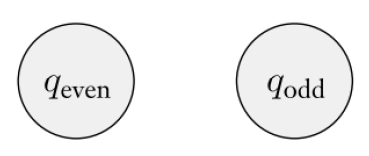
DESIGNING FINITE AUTOMATA
Example 1
Possibilities so far would be- Even so far Odd so far Assign states to these possibilities

Slide 94
DESIGNING FINITE AUTOMATA
Example 1
Assign the transitions by seeing how to go from one possibility to another upon reading a symbol

Slide 95
DESIGNING FINITE AUTOMATA
Example 1
For Assigning the transitions by seeing how to go from one possibility to another upon reading a symbol Check for strings 0 00 001 010 01011 01011011

Slide 96
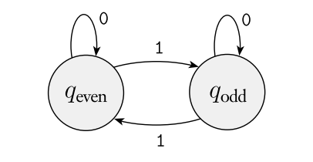
DESIGNING FINITE AUTOMATA
Example 1
Assign the transitions by seeing how to go from one possibility to another upon reading a symbol

Slide 97
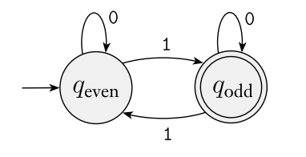
DESIGNING FINITE AUTOMATA
Example 1
Add the start state Set the start state to be the state corresponding to the possibility associated with having seen 0 symbols (Zero occurrences of 1s) so far (the empty string ε) As 0 is an even number, Start state corresponds to q_{even}

Slide 98
DESIGNING FINITE AUTOMATA
Example 1
Add the accept state Accept state to be those corresponding to possibilities where you want to accept the input string. q_{odd} is set as an accept state

Slide 99
DESIGNING FINITE AUTOMATA
Example 2
Design a finite automaton E2 to recognize all strings that contain the string 001 as a substring. For example, 0010, 1001, 001, and 11111110011111 are all in the language, but 11 and 0000 are not.

Slide 101
DESIGNING FINITE AUTOMATA- RECOGNIZER FA AS A SEQUENCE DETECTOR

Slide 102
DESIGNING FINITE AUTOMATA
Example 2
Pretending to be the Automaton E2 recognize the language Start reading the input string of 0s and 1s symbol by symbol

Slide 103
DESIGNING FINITE AUTOMATA
Example 2-Design a finite automaton E2 to recognize all strings that contain the string 001 as a substring.
As symbols come in, you would initially skip over all 1’s So the 4 possibilities are- Haven’t seen any symbols of the pattern=> q state= start state Have just seen a 0=>q₀ state Have just seen 00=>q₀₀ state Have seen the entire pattern 001=>q₀₀₁ state

Slide 104
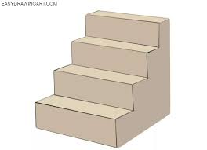
??

Slide 105
DESIGNING FINITE AUTOMATA
Example 2-Assign transitions
FA moves from start state q to q₀, only if “0” is read, Otherwise remains in the same state q reading a 0, you move to q₀ q reading a 1, you stay in q
q₀ reading a 1, you return to q q₀ reading a 0, you move to q₀₀
q₀₀ reading a 1, you move to final state q₀₀₁ q₀₀ reading a 0, stays in q₀₀
q₀₀₁ reading a 0 or 1, stays in q₀₀₁ If FA reads any symbol after reaching final state q₀₀₁, it does not make a transition to any other state as it has already recognized the string “001” by then

Slide 106
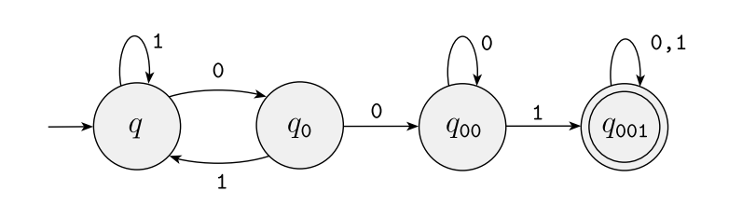
DESIGNING FINITE AUTOMATA
Example 2
Assign transitions q reading a 1, you stay in q q reading a 0, you move to q₀ q₀ reading a 1 you return to q q₀ reading a 0, you move to q₀₀ q₀₀ reading a 1, you move to q₀₀₁ q₀₀ reading a 0, stays in q₀₀ q₀₀₁ reading a 0 or 1, stays in q₀₀₁

Slide 107
DESIGNING FINITE AUTOMATA
Example 2
Start state =q The only accept state =q₀₀₁

Slide 108
DESIGNING FINITE AUTOMATA
Exercise
Design a DFA with inputs as characters of “CHARIOT” which recognizes the string “CAT” as substring.

Slide 109
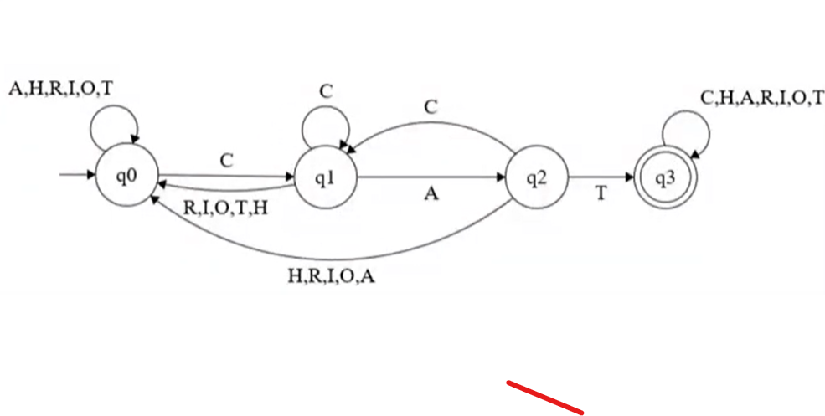
DESIGNING FINITE AUTOMATA
Exercise
Design a DFA with inputs as characters of “CHARIOT” which recognizes the string “CAT” as substring.

Slide 110
DESIGNING FINITE AUTOMATA
Example 3
Let us formally specify a DFA that accepts all and only the strings of 0’s and 1’s that have the sequence 01 somewhere in the string.

Slide 111
DESIGNING FINITE AUTOMATA
Example 3
Pretending to be the Automaton E3 recognize the language Start reading the input string of 0s and 1s symbol by symbol

Slide 112
DESIGNING FINITE AUTOMATA
Example 3
As symbols come in, you would initially skip over all 1’s So the 3 possibilities are- Haven’t seen any symbols of the pattern=> q state Have just seen a 0=>q₀ state Have seen the entire pattern 01=>q₀₁ state

Slide 113
DESIGNING FINITE AUTOMATA
Example 3
Assign transitions q reading a 1, you stay in q q reading a 0, you move to q₀ q₀ reading a 0, stays in q₀ q₀ reading a 1, you move to q₀₁ q₀₁ reading a 0 or 1, stays in q₀₁

Slide 114
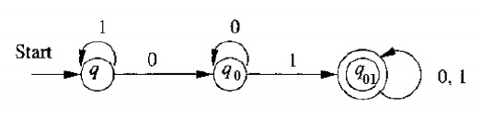
DESIGNING FINITE AUTOMATA
Example 3
Assign transitions q reading a 1, you stay in q q reading a 0, you move to q₀ q₀ reading a 0, stays in q₀ q₀ reading a 1, you move to q₀₁ q₀₁ reading a 0 or 1, stays in q₀₁

Slide 115
DESIGNING FINITE AUTOMATA
Example 3
Start state =q The only accept state =q₀₁

Slide 116
DESIGNING FINITE AUTOMATA
Example 3
We can write this language L as: {w | w is of the form x01y for some strings x and y consisting of 0’s and 1’s only.} Another equivalent description, using parameters x and y to the left of the vertical bar, is: {x01y | x and y are any strings of 0’s and 1’s}

Slide 117
DESIGNING FINITE AUTOMATA
Exercise 1
Construct a DFA accepting set of string over {a, b} where each string containing ‘a’ as the substring.

Slide 118
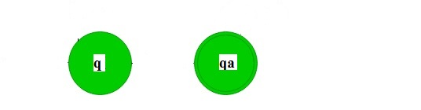
DESIGNING FINITE AUTOMATA
Exercise 1
As symbols come in, you would initially skip over all b’s So the 2 possibilities are- Haven’t seen any “a” symbol => q state Have just seen an “a”=>q_{a} state

Slide 119
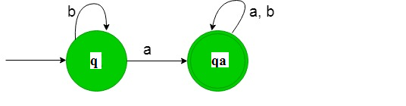
DESIGNING FINITE AUTOMATA
Exercise 1
Assign transitions q getting “b”, stays in state q itself q reading “a”, it transits to the final state q_{a} q_{a} On reading a or b , stays in the final state q_{a} itself.
Strings
a
aa
aab
aabb

Slide 120
DESIGNING FINITE AUTOMATA
Exercise 1
Start state =q The only accept state =q_{a}

Slide 121
DESIGNING FINITE AUTOMATA
Exercise 2
Construction of a minimal DFA accepting set of string over {a, b} where each string containing ‘ab’ as the substring.

Slide 122
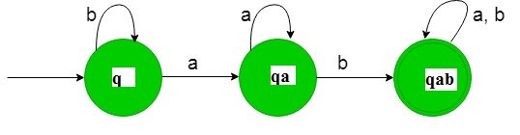
DESIGNING FINITE AUTOMATA
Exercise 2
Construction of a minimal DFA accepting set of string over {a, b} where each string containing ‘ab’ as the substring.
https://www.geeksforgeeks.org/designing-deterministic-finite-automata-set-3/

Slide 123
DESIGNING FINITE AUTOMATA
Example 4
Construction of a DFA to check whether given decimal number is divisible by three

Slide 124
DESIGNING FINITE AUTOMATA
Example 4
The possible Remainders =0,1,2 Remainder 0=>Divisible by 3 Group Digits according to their remainder Initial State=A (0,3,6,9,12,15…)mod 3=0, Remainder 0 group S0=>Final State (1,4,7,10,13,16…)mod 3=1, Remainder 1 group S1 (2,5,8,11,14,17…)mod 3=2, Remainder 2 group S2

Slide 125
DESIGNING FINITE AUTOMATA
Example 4
Single Digits (0,3,6,9…) mod 3=0, Remainder 0 group S0=>Final State (1,4,7) mod 3=1, Remainder 1 group S1 (2,5,8) mod 3=2, Remainder 2 group S2
S0
A
0,3,6,9
1,4,7
2,5,8
S2
S1

Slide 126
DESIGNING FINITE AUTOMATA
Example 4
Double Digits (0,3,6,9…) mod 3=0, Remainder 0 group S0=>Final State For 12, Remainder 0 For 15, Remainder 0 For 18, Remainder 0
S0
A
0,3,6,9
1,4,7
2,5,8
2,5,8
S2
S1

Slide 127
DESIGNING FINITE AUTOMATA
Example 4
Double Digits (1,4,7) mod 3=1, Remainder 1 group S1 For 10, Remainder 1 For 13, Remainder 1 For 16, Remainder 1 For 19, Remainder 1
S0
A
0,3,6,9
1,4,7
2,5,8
2,5,8
S2
S1
0,3,6,9

Slide 128
DESIGNING FINITE AUTOMATA
Example 4
Double Digits (2,5,8,11,14,17…)mod 3=2, Remainder 2 group S2 For 11, Remainder 2 For 14, Remainder 2 For 17, Remainder 2
S0
A
0,3,6,9
1,4,7
2,5,8
2,5,8
S2
1,4,7
S1
0,3,6,9

Slide 129
DESIGNING FINITE AUTOMATA
Example 4
Double Digits For 21, Remainder 0 For 24, Remainder 0 For 27, Remainder 0
S0
A
0,3,6,9
1,4,7
2,5,8
2,5,8
S2
1,4,7
S1
1,4,7
0,3,6,9

Slide 130
DESIGNING FINITE AUTOMATA
Example 4
Double Digits For 22, Remainder 1 For 25, Remainder 1 For 28, Remainder 1
S0
A
0,3,6,9
1,4,7
2,5,8
2,5,8
S2
1,4,7
S1
2,5,8
1,4,7
0,3,6,9

Slide 131
DESIGNING FINITE AUTOMATA
Example 4
Double Digits For 20, Remainder 2 For 23, Remainder 2 For 26, Remainder 2 For 29, Remainder 2
S0
A
0,3,6,9
1,4,7
2,5,8
2,5,8
S2
1,4,7
S1
0,3,6,9
2,5,8
1,4,7
0,3,6,9

Slide 132
DESIGNING FINITE AUTOMATA
Example 4
Double Digits For 30, Remainder 0 For 33, Remainder 0 For 36, Remainder 0 For 39, Remainder 0
0,3,6,9
S0
A
0,3,6,9
1,4,7
2,5,8
2,5,8
S2
1,4,7
S1
0,3,6,9
2,5,8
1,4,7
0,3,6,9

Slide 133
DESIGNING FINITE AUTOMATA
Example 4
Double Digits For 31, Remainder 1 For 34, Remainder 1 For 37, Remainder 1
0,3,6,9
S0
A
0,3,6,9
1,4,7
2,5,8
2,5,8
1,4,7
S2
1,4,7
S1
0,3,6,9
2,5,8
1,4,7
0,3,6,9

Slide 134
DESIGNING FINITE AUTOMATA
Example 4
Double Digits For 32, Remainder 2 For 35, Remainder 2 For 38, Remainder 2
0,3,6,9
2,5,8
S0
A
0,3,6,9
1,4,7
2,5,8
2,5,8
1,4,7
S2
1,4,7
S1
2,5,8
1,4,7
0,3,6,9
0,3,6,9

Slide 135
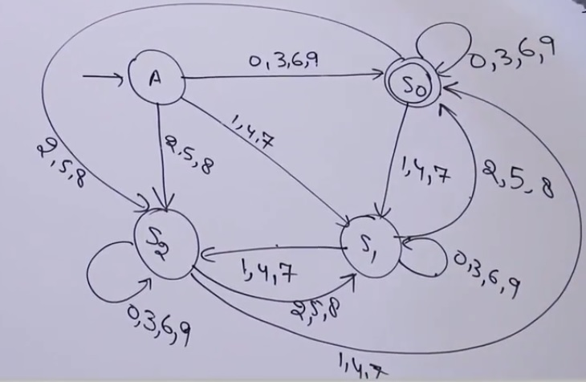
DESIGNING FINITE AUTOMATA
Example 4
Complete DFA

Slide 136
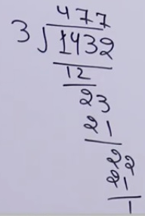
DESIGNING FINITE AUTOMATA
Example 4
Lets check for 1432,1431 On traversing for 1432, finally we reach state s1 i.e. Remainder 1, On traversing for 1431, finally we reach state s0 i.e. Remainder 0

Slide 137
DESIGNING FINITE AUTOMATA
Example 5
Design a DFA which checks whether the given binary number is even

Slide 138
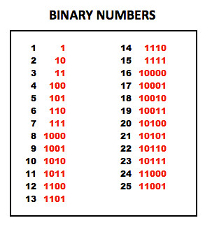
DESIGNING FINITE AUTOMATA
Example 5
Binary number that ends with zero=Even Binary number that ends with one=Odd

Slide 139
DESIGNING FINITE AUTOMATA
Example 5
Possibilities: Start state=S0 State ending in 1=S1 State ending in 0=Even numbers=Final state=S2
S2
S0
S1

Slide 140
DESIGNING FINITE AUTOMATA
Example 5
String – Decimal 0=String 0=State ending in 0 Decimal 1=String 1=State ending in 1
S2
0
S0
S1
1

Slide 141
DESIGNING FINITE AUTOMATA
Example 5
String – Decimal 2=10=State ending in 0 Decimal 3=11=State ending in 1 Decimal 4=100=State ending in 0 Decimal 5=101=State ending in 1
0
S2
0
S0
1
0
S1
1
1

Slide 142
DESIGNING FINITE AUTOMATA
Example 5
Check for bigger numbers Decimal 64= 1000000=State ending in 0 Decimal 27=11011=State ending in 1
0
S2
0
S0
1
0
S1
1
1

Slide 143
DESIGNING FINITE AUTOMATA
Example 6
Design a DFA which accepts only those binary numbers which start with 1 and ends with 0.

Slide 144
DESIGNING FINITE AUTOMATA
Example 6
Design a DFA which accepts only those binary numbers which start with 1 and ends with 0. Initial state S0 S0 reads 1, moves to S1 String 10 S1 reads 0, moves to S2=Final state
1
0
S0
S1
S2

Slide 145
DESIGNING FINITE AUTOMATA
Example 6
String 1010 Also check for strings- 10 110 1110 1010 101010 10101000
1
0
S0
S1
S2
1

Slide 146
DESIGNING FINITE AUTOMATA
Example 6
String 10110
1
0
S0
S1
S2
1
1

Slide 147
DESIGNING FINITE AUTOMATA
Example 6
String 1000
0
1
0
S0
S1
S2
1
1

Slide 148
DESIGNING FINITE AUTOMATA
Example 7
Design a DFA which checks whether a given binary number is divisible by three

Slide 149
DESIGNING FINITE AUTOMATA
Example 7
The possible Remainders =0,1,2 Remainder 0=>Divisible by 3 Group Digits according to their remainder Initial State=A Remainder 0 group S0=>Final State Remainder 1 group S1 Remainder 2 group S2
A
S0
S1
S2

Slide 150
DESIGNING FINITE AUTOMATA
Example 7
Binary –Decimal => 0-0 , Rem=0,State S0 01-1, Rem=1, State S1 10-2 , Rem=2, State S2
A
0
S0
1
S1
S2
0

Slide 151
DESIGNING FINITE AUTOMATA
Example 7
Binary –Decimal => 11-3 , Rem=0, State S0
A
0
S0
1
1
S1
S2
0

Slide 152
DESIGNING FINITE AUTOMATA
Example 7
Binary –Decimal => 100-4 , Rem=1, State S1
A
0
S0
1
1
S1
0
S2
0

Slide 153
DESIGNING FINITE AUTOMATA
Example 7
Binary –Decimal => 101-5 , Rem=2, State S2
A
0
S0
1
1
1
S1
0
S2
0

Slide 154
DESIGNING FINITE AUTOMATA
Example 7
Binary –Decimal => 110-6 , Rem=0, State S0
0
A
0
S0
1
1
1
S1
0
S2
0

Slide 155
DESIGNING FINITE AUTOMATA
Example 7
Binary –Decimal => 111-7 , Rem=1, State S1
0
A
0
S0
1
1
1
1
S1
0
S2
0

Slide 156
DESIGNING FINITE AUTOMATA
Example 7
For any Bigger Number Binary –Decimal => 10111-23 , Rem=2, State S2 Yes, Satisfied
0
A
0
S0
1
1
1
1
S1
0
S2
0

Slide 157
DESIGNING FINITE AUTOMATA
Example 8
Design a DFA to accept a Language L where all strings in L are such that total number of a’s in them are divisible by 3

Slide 158
DESIGNING FINITE AUTOMATA
Example 8
There is no condition that a should be in clumps But Total number of a’s should be divisible by 3 No conditions on b’s b’s are allowed in between

Slide 159
DESIGNING FINITE AUTOMATA
Example 8
Total no of a’s should be multiples of 3 i.e Total no of a’s can be 0=>Initial state can be final state Total no of a’s can be 3 Total no of a’s can be 6 Total no of a’s can be 9 and so on… And whenever count of no of a’s is 0/3/6/9/12/15…so on The string should be accepted i.e. it should be final state

Slide 160
DESIGNING FINITE AUTOMATA
Example 8
Design a DFA to accept a Language L where all strings in L are such that total number of a’s in them are divisible by 3
b
b
b
a
S1
a
S2
S0
a

Slide 161
DESIGNING FINITE AUTOMATA
Example 9
Design a DFA to accept the language L(M) = {w | w ε {0, 1}*} and W is a string that does not contain three consecutive 1's.

Slide 162
DESIGNING FINITE AUTOMATA
Example 9
When three consecutive 1's occur the DFA will be: Here two consecutive 1's or single 1 is acceptable, hence The stages q0, q1, q2 are the final states.

Slide 163
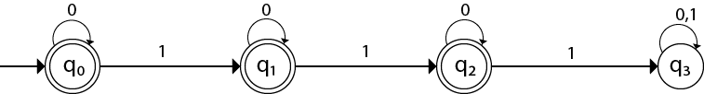
DESIGNING FINITE AUTOMATA
Example 9
String 111 will be in q3 state=Non final state=Rejected
String 10110111 will be in q3 state=Non final state=Rejected

Slide 164
DESIGNING FINITE AUTOMATA
Example 9
String 0110 accepted
Strings 1011101 rejected
Correct till now……

Slide 165
DESIGNING FINITE AUTOMATA
Example 9
Exactly three 1’s but not consecutive giving Error-
String 1101 rejected
String 11010 rejected
String 10110 rejected
String 1011 rejected
The above strings should be accepted as the 1’s are not consecutive
Strings 110110 rejected-No of 1’s increases to 4=>Works perfectly

Slide 166
DESIGNING FINITE AUTOMATA
Example 9
Change to be done-
Change Outgoing transition from q1 and q2

Slide 167
DESIGNING FINITE AUTOMATA
Example 9
X
X
Change to be done-
Change Outgoing transition from q1 and q2
For Strings 1101,11010 –
Outgoing transition for 0 from q2 should go to q1
so that strings like 11011 should be rejected

Slide 168
DESIGNING FINITE AUTOMATA
Example 9
X
X
Change to be done-
Change Outgoing transition from q1 and q2
For Strings like 10110, 1011
Outgoing transition for 0 from q1 should go to q0
so that strings like 101101 should be rejected
0
0

Slide 169
DESIGNING FINITE AUTOMATA
Example 10
Design a DFA to accept the language L(M) = {0^{m}1^{n} | m>=0 and n>=1 }

Slide 170
DESIGNING FINITE AUTOMATA
Example 10-Design a DFA to accept the language L(M) = {0^{m}1^{n} | m>=0 and n>=1 }
All 0s are followed by 1s No of zeros can be 0 No of ones has to be minimum 1, so one transition for 1 has to be there

Slide 171
DESIGNING FINITE AUTOMATA
Example 10-Design a DFA to accept the language L(M) = {0^{m}1^{n} | m>=0 and n>=1 }
No of zeros can be 0=>can be associated with start state No of ones has to be minimum 1, so one transition for 1 has to be there=>final state
0
1
S0
1
S1

Slide 172
DESIGNING FINITE AUTOMATA
Example 11
Design a DFA which accepts all the strings not having more than 2 a’s over ∑={a,b}

Slide 173
DESIGNING FINITE AUTOMATA
Example 11
Design a DFA which accepts all the strings not having more than 2 a’s over ∑={a,b}
b
b
b
a,b
a
a
q2
a
q3
q0
q1

Slide 174
DESIGNING FINITE AUTOMATA
Example 11
String aaba-Rejected String bba-Accepted String baba –Accepted String aabbab-Rejected
b
b
b
a,b
a
a
q2
a
q3
q0
q1

Slide 175
DESIGNING FINITE AUTOMATA
Example 12
Recognize the language given by following DFA
a
a,b
q0
b
a,b
q2
q1

Slide 176
DESIGNING FINITE AUTOMATA
Example 12-Recognize the language given by following DFA
a
a,b
q0
b
a,b
q2
q1

Slide 177
DESIGNING FINITE AUTOMATA
Example 13
Design a DFA over ∑={a,b} for (ab)^{n} for n>=0

Slide 178
DESIGNING FINITE AUTOMATA
Example 14
Design a DFA over ∑={a,b} for (ab)^{n} for n>=1

Slide 179

DESIGNING FINITE AUTOMATA
Example 15
Design a FA with ∑ = {0, 1} accepts the only input 101.

Slide 180
NDFA

Slide 181
NDFA
Non Deterministic Automata
DFA vs NDFA
The Difference is in the type of transition function

Slide 182
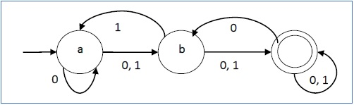
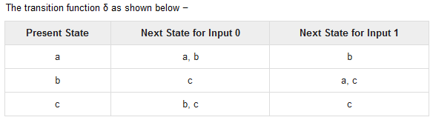
NDFA
Let a non-deterministic finite automaton be →
Q = {a, b, c}
∑ = {0, 1}
q₀ = {a}
F = {c}

Slide 183
NDFA
DFA | NDFA
Transition function takes a state and an input symbol and produces the next state | Transition function takes a state and an input symbol or the empty string and produces the set of possible next states

Slide 184
NDFA
Non Deterministic Automata
Similar to DFA
Both have states, ∑, δ , start state, accept states
Difference lies in δ

Slide 185
Formal Definition of NDFA
A NDFA is 5 tuple Machine
M=(Q, ∑, δ, q₀, F) where
Q:Finite set of states
∑:Finite input alphabet
δ:Q X ∑∈ ->P(Q) State Transition function(STF)
q₀: Initial/Start state of FA, q₀ ∈ Q
F: Set of Final States/ Accept State, F ⊆ Q
P(Q)=Power Set of Q=2^{Q} states, the set of all subsets of Q

Slide 186
Formal Definition of NDFA
Need not construct δ for all these 2^{Q} states , But for all states reachable from q0
We continue construction of δ by considering only states appearing earlier under input columns
We halt when no more new state appear under the input column

Slide 187
Example 1
Construct a Deterministic automaton equivalent to M1=({qo,q1},{0,1},δ,q0,{q0}) where δ is given by the following table
States | 0 | 1
q0 | q0 | q1
q1 | q1 | q0,q1

Slide 188
Example 1
Construct a Deterministic automaton equivalent to M1=({qo,q1},{0,1},δ,q0,{q0}) where δ is given by the following table
States | 0 | 1
q0 | q0 | q1
q1 | q1 | q0,q1

Slide 189
Example 1
NDFA M1
DFA M1
States | 0 | 1
q0 | q0 | q1
q1 | q1 | q0,q1
States | 0 | 1
[q0] | [q0] | [q1]
[q1] | [q1] | [q0,q1]
[q0,q1] | [q0,q1] | [q0,q1]

Slide 190
Formal Definition of NDFA
Formal Definition-
M={ { q0, q1, [q0,q1] } , {0,1} , {q0} , { [q0] , [q0q1] } }
Set of States= { q0, q1, [q0,q1] }
Input alphabet= {0,1}
Start State= {q0}
Final States= { [q0] , [q0q1] }

Slide 191
NDFA M1
States | 0 | 1
q0 | q0 | q1
q1 | q1 | q0,q1
0
0,1
q0
1
q1
1
‹#›

Slide 192
NDFA converted to DFA
DFA M1
States | 0 | 1
[q0] | [q0] | [q1]
[q1] | [q1] | [q0,q1]
[q0,q1] | [q0,q1] | [q0,q1]
0
0
0
1
q1
1
q0
[q0q1]
1
‹#›

Slide 193
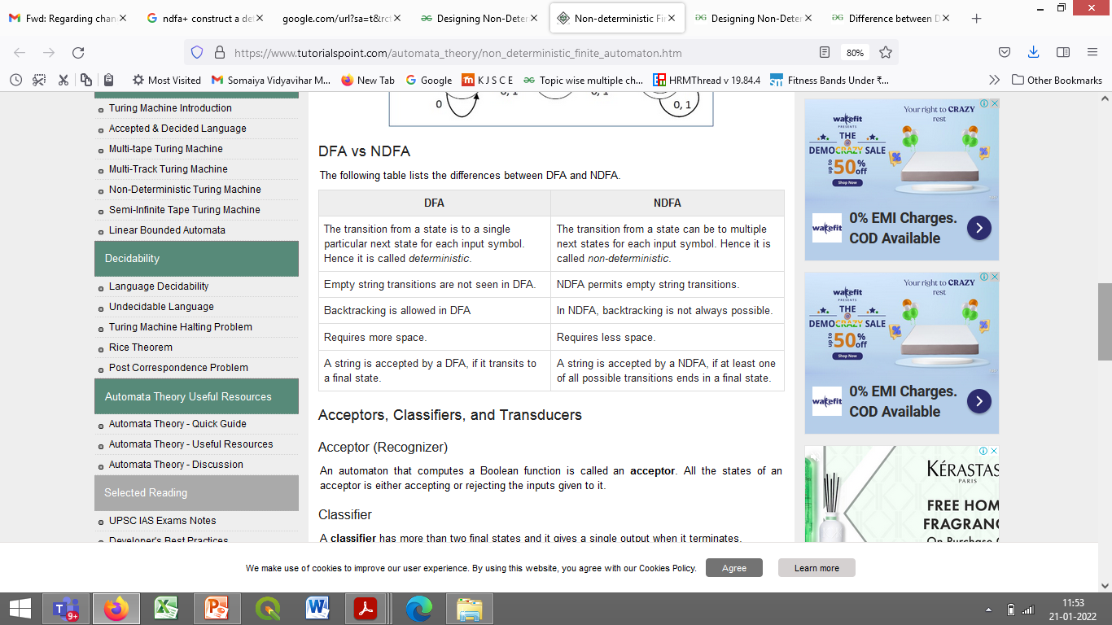

Slide 194
Non-Determinism?
Determinism-
When the machine is in a given state and reads the next input symbol, we know what the next state will be-It is determined
Called as Determined computation
Non-Determinism-
Several choices may exist for the next state at any point

Slide 195
Conversion of NDFA to DFA/Equivalence of DFA and NDFA
DFA can do whatever NFA’s can do
Converting a NDFA N to DFA D such that L(N)=L(D)
Involves Subset Construction
Involves constructing all subsets of the set of states of the NDFA

Slide 196
Conversion of NDFA to DFA/Equivalence of DFA and NDFA
δ:Q X ∑∈ ->P(Q)
P(Q)=Power set of Q =2^{Q} states
Eg-
Q = {q1,q2,q3}
P(Q) = {ø} , {q1} , {q2}, {q3}, {q1,q2}, {q1,q3}, {q2,q3}, {q1,q2,q3}
Not all states are accessible from start state
Inaccessible states can be thrown away

Slide 197
Conversion of NDFA to DFA/Equivalence of DFA and NDFA
Start states are same
Input alphabet is same
Final State of DFA is sets of all states that include atleast one accepting state of NDFA

Slide 198
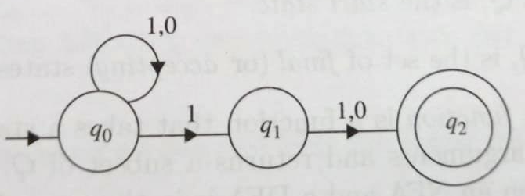
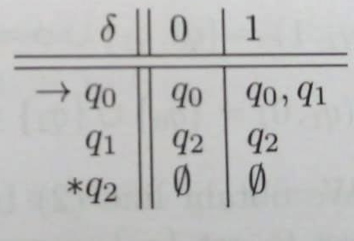
Example 2
Consider The automaton M given in the figure that accepts all strings which have the symbol 1 in the second last position. Convert to DFA
Transition Table is -

Slide 199
q0 is the start state of the NDFA and DFA both
δ({q0},0)={q0}
δ({q0},1)={q0,q1}, For input 1, there are arcs to both q0 and q1
We get one row of the transition table-
States | 0 | 1
q0 | {q0} | {q0,q1}

Slide 200
One of the sets we compute is old {q0}, already computed
{q0,q1} is new and its transitions must be computed
δD({q0,q1},0)= δN(q0,0) U δN(q1,0) ={qo} U {q2}={q0,q2}
δD({q0,q1},1)= δN(q0,1) U δN(q1,1) ={qo,q1} U {q2} ={q0,q1,q2}
We get second row of the transition table-
States | 0 | 1
q0 | {q0} | {q0,q1}
{q0,q1} | {q0,q2} | {q0,q1,q2}

Slide 201
{q0,q2} is new and its transitions must be computed
δD({q0,q2},0)= δN(q0,0) U δN(q2,0) ={q0} U ø ={q0}
δD({q0,q2},1)= δN(q0,1) U δN(q2,1) ={q0,q1} U ø={q0,q1}
We get third row of the transition table-
States | 0 | 1
q0 | {q0} | {q0,q1}
{q0,q1} | {q0,q2} | {q0,q1,q2}
{q0,q2} | {q0} | {q0,q1}

Slide 202
{q0,q1,q2} is new and its transitions must be computed
δD({q0,q1,q2},0)= δN(q0,0) U δN(q1,0) U δN(q2,0) ={q0} U {q2} U ø={q0,q2}
δD({q0,q1,q2},1)= δN(q0,1) U δN(q1,1) U δN(q2,1) ={qo,q1} U {q2} U ø={q0,q1,q2}
We get fourth row of the transition table-
States | 0 | 1
q0 | {q0} | {q0,q1}
{q0,q1} | {q0,q2} | {q0,q1,q2}
{q0,q2} | {q0} | {q0,q1}
{q0,q1,q2} | {q0,q2} | {q0, q1,q2}

Slide 203
Transition Table
States | 0 | 1
q0 | {q0} | {q0,q1}
{q0,q1} | {q0,q2} | {q0,q1,q2}
{q0,q2} | {q0} | {q0,q1}
{q0,q1,q2} | {q0,q2} | {q0, q1,q2}
0
{q0}
1
1
{q0,q1}
{q0,q2}
{q0,q1,q2}
0
0
0
1
1

Slide 204
NDFA
Example 3
Find a determinant acceptor equivalent to M=({qo,q1,q2},{a,b}, δ,q0,{q2}) Transition Table-
States | a | b
q0 | q0,q1 | q2
q1 | q0 | q1
q2 | - | q0,q1

Slide 205
NDFA
Example 3
Transition Table of NDFA- Transition Table of DFA- Need not construct δ for all these 2^{Q} states , But for all states reachable from q0
States | a | b
q0 | q0,q1 | q2
q1 | q0 | q1
q2 | - | q0,q1

Slide 206
NDFA
Example 3
Transition Table of NDFA- Transition Table of DFA-
States | a | b
q0 | q0,q1 | q2
q1 | q0 | q1
q2 | - | q0,q1
States | a | b
{q0} | {q0,q1} | {q2}
{q0,q1} | {q0,q1} | {q1,q2}
{q2} | ø | {q0,q1}
{q1,q2} | {q0} | {q0,q1}

Slide 207
NDFA
Example 3
Transition Table of DFA-
States | a | b
{q0} | {q0,q1} | {q2}
{q0,q1} | {q0,q1} | {q1,q2}
{q2} | ø | {q0,q1}
{q1,q2} | {q0} | {q0,q1}
a
b
b
{q0}
a
{q0,q1}
{q2}
{q1,q2}
b
ø
a
a
b

Slide 208
NDFA
Example 4
Find a determinant acceptor equivalent to M=({qo,q1,q2,q3},{a,b}, δ,q0,{q3}) Transition Table-
States | a | b
q0 | q0,q1 | q0
q1 | q2 | q1
q2 | q3 | q3
q3 | - | q2

Slide 209
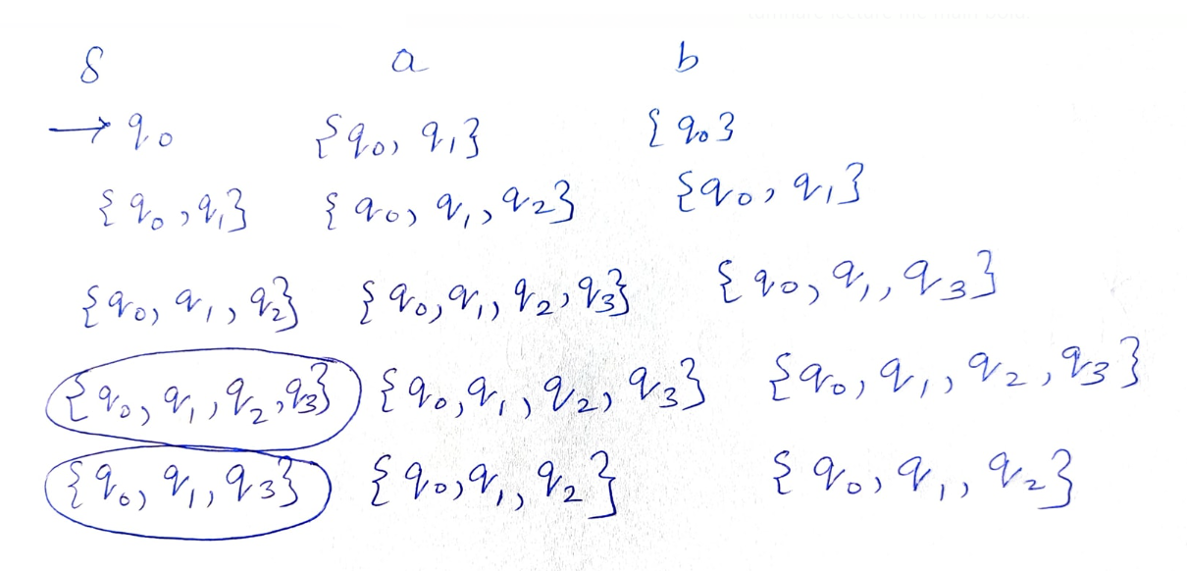
Example 4-Transition Table
States | a | b
q0 | q0,q1 | q0
q1 | q2 | q1
q2 | q3 | q3
q3 | - | q2

Slide 210
NDFA
Example 5
Find a determinant acceptor equivalent to Automaton with Transition Table-
States | 0 | 1 | 2
q0 | q1,q4 | q4 | q2,q3
q1 | - | q4 | -
q2 | - | - | q2,q3
q3 | - | q4 | -
q4 | - | - | -

Slide 211
Example 5-Transition Table of NDFA-
States | 0 | 1 | 2
q0 | q1,q4 | q4 | q2,q3
q1 | - | q4 | -
q2 | - | - | q2,q3
q3 | - | q4 | -
q4 | - | - | -
States | 0 | 1 | 2
{q0} | {q1,q4} | {q4} | {q2,q3}
{q1,q4} | ø | {q4} | Ø
{q4} | ø | ø | Ø
{q2,q3} | ø | {q4} | {q2,q3}

Slide 212
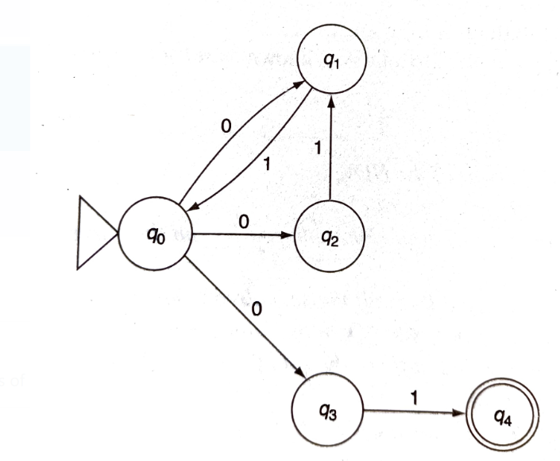
Convert the NDFA to DFA

Slide 213
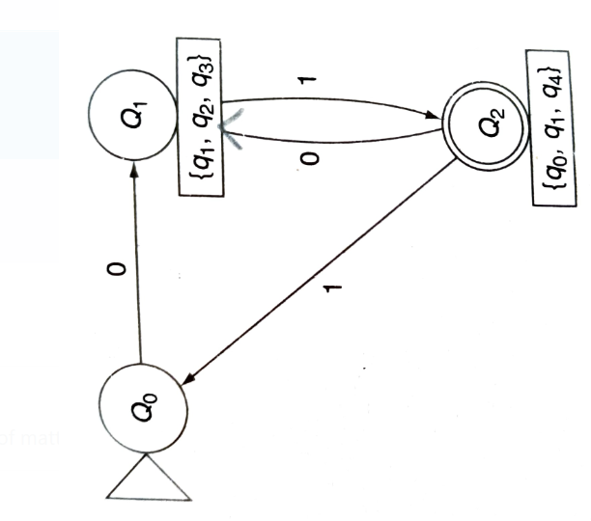
Convert the NDFA to DFA

Slide 214
DFA Minimization
Partitioning Method
Box Method/Myhill Nerode Theorem

Slide 215
Myhill Nerode Theorem/Box State
Step 1- Remove all states which are not reachable from the start state
Step 2- Create a box table such that rows and columns are identified by state names
X Axis is comprised of first to second last state
Y Axis is comprised of second to last state
Step 3-All the cells in which one state is final and the other is non-final are marked with “X”

Slide 216
Myhill Nerode Theorem
Step 4-If there are some unmarked cells then check whether they can be marked as follows-
Let (p,q) be an unmarked cell and let “a” be some input symbol
If δ(p,a)=r and δ(q,a)=r then No Decision can be taken wrt this input
If δ(p,a)=r and δ(q,a)=s then mark cell (p,q) with “X” if cell(r,s) is marked with “X”
If cell(p,q) is unmarked wrt input “a” then repeat step 4 with another input available

Slide 217
Myhill Nerode Theorem
Step 5- All those cells which are unmarked can be merged into single state respectively
These states are equivalent states
The equivalent states have identical transitions on input values

Slide 218
Myhill Nerode Theorem
Set of accepting states of Minimized DFA is the set of states containing accepting states of DFA
If one state of a set is accepting, then all the states of that set must be accepting.
Any accepting state is distinguishable from non-accepting state so you cant have both accepting and non accepting states in one set.

Slide 219
DFA Minimization-Example 1

Slide 220
DFA Minimization-Example 1

Slide 221
DFA Minimization-Example 1

Slide 222
DFA Minimization-Example 1

Slide 223
DFA Minimization-Example 1

Slide 224
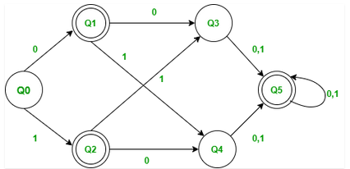
Example2 DFA Minimization Using Box Method

Slide 225
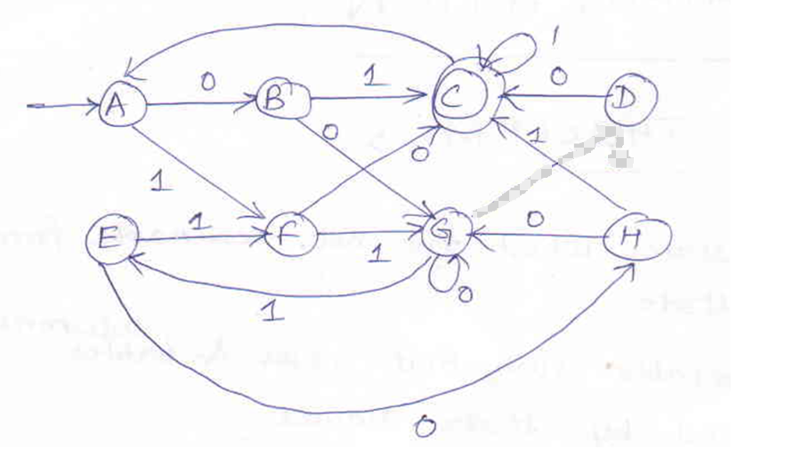
DFA Minimization-Example 2- To be solved by students Construct the Minimized DFA for the following DFA-
0
X

Slide 226
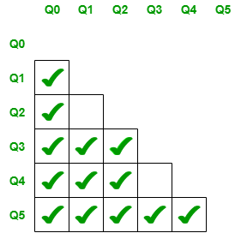

Q1 DFA Minimization Using Box Method 10 Mrks
https://www.geeksforgeeks.org/minimization-of-dfa-using-myhill-nerode-theorem/

Slide 227
Lecture 1/2/2022

Slide 228
Minimization of DFA-Successive Partitioning Method
Method of Successive Partitioning
Also called Equivalence Partitioning
To find Distinguishable/Non-Distinguishable states

Slide 229
Minimization of DFA-Successive Partitioning Method
Step 1-
Divide P, The set of states into two sets
One set will contain final states of DFA
Another set will contain remaining non-final states.
This Partition is called P0
As every final state is distinguishable from a non-final state
Step 2-
We find transitions from members of each partition on every input symbol

Slide 230
Minimization of DFA-Successive Partitioning Method
Step 3-
If for an input symbol, the transitions from some members of the partition goes to one partition whereas transitions from other members of a partition goes to some other partition=> These members are distinguishable
We do partitioning, to get P1 set
We continue partitioning, till no further partitioning is possible

Slide 231
Minimization of DFA-Successive Partitioning Method
Step 4-
In the end, If we get a partition with more than one state, i.e. they are not distinguishable, We merge all the states of this partition into a single state

Slide 232
Minimization of DFA-Successive Partitioning Method
Note-
For an input symbol a
If δ(qi,a) and δ(qj,a) are in different sets in P then (qi,qj) pair is distinguishable
If distinguishable , we will split the sets into different sets

Slide 233
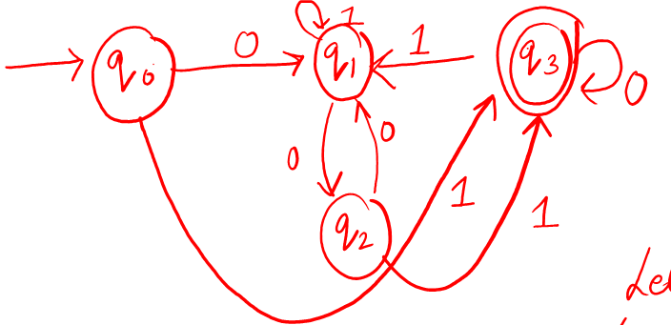
Perform DFA Minimization using Successive Partitioning Method

Slide 234
v

Slide 236
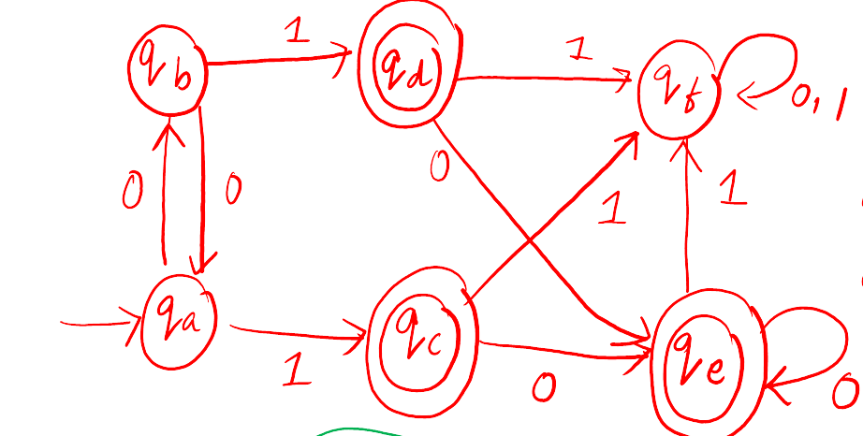
Perform DFA Minimization using Successive Partitioning Method

Slide 239
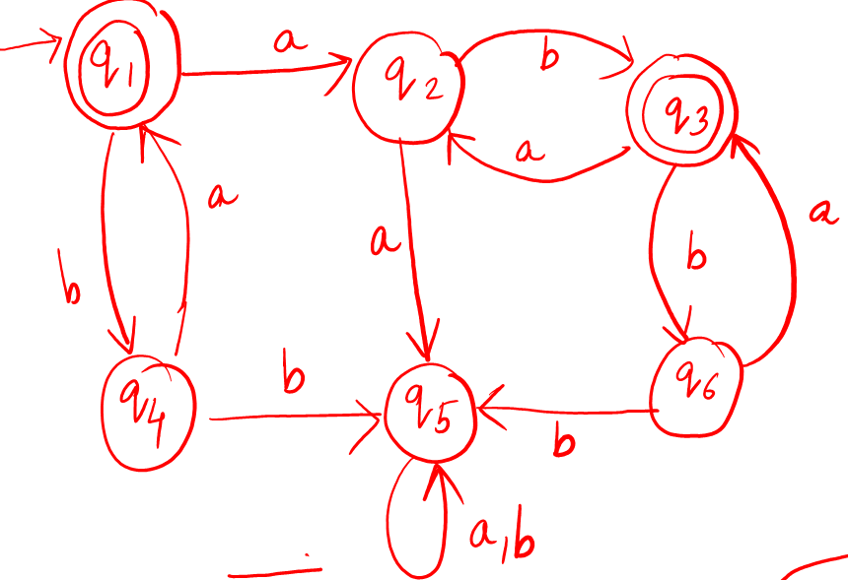
Minimize the DFA using succesive partition method

Slide 241
Finite Automata with Output
Moore Machine
Mealey Machine

Slide 242
Moore Machine
Named after Edward f. Moore who presented the concept in a 1956 paper “Gedanken experiments” on Sequential machine

Slide 243
Moore Machine
Machine with Finite number of states for which the Output symbol/values at a given time depends only upon the present state of a machine
Moore machine is a finite state machine in which the next state is decided by the current state and current input symbol.

Slide 244
Moore Machine-Formal Definition
6 tuple representation
Moore Machine is denoted by 6 Tuple: M=(Q, ∑, Δ,δ, λ, q₀) where

Slide 245
Moore Machine-Formal Definition
6 tuple representation
Moore Machine is denoted by 6 Tuple: M=(Q, ∑, Δ,δ, λ, q₀) where
Q:Finite set of states
∑:Finite input alphabet
Δ or O:Finite set of Output alphabet
δ:Q X ∑ ->Q State Transition function(STF)
Mapping State and input alphabet to the next state
λ:Q->Δ or O Machine Function/Output function
Mapping each state to the Output alphabet
q₀: Initial/Start state of FA, q0 ∈ Q

Slide 246
Moore Machine-Formal Definition
In Moore Machine, there is no final state
Output is associated with a state
State produces output irrespective of what input/transition is made

Slide 247
Moore Machine-State Diagram
Draw the state diagram for the Moore Machine given below:-
State or Transition Function
δ:Q X ∑ ->Q State Transition function(STF)
λ:Q->Δ or O Machine Function/Output function
States | a | b
qo | q3 | q1
q1 | q1 | q2
q2 | q2 | q3
q3 | q3 | q0
States | Δ/O
q0 | 0
q1 | 1
q2 | 0
q3 | 0

Slide 248
Moore Machine-State Diagram
States | a | b
qo | q3 | q1
q1 | q1 | q2
q2 | q2 | q3
q3 | q3 | q0
States | Δ/O
q0 | 0
q1 | 1
q2 | 0
q3 | 0

Slide 249
Moore Machine-State Diagram
State or Transition Function
δ:Q X ∑ ->Q State Transition function(STF)
λ:Q->Δ or O Machine Function/Output function
States | a | b
qo | q3 | q1
q1 | q1 | q2
q2 | q2 | q3
q3 | q3 | q0
States | Δ/O
q0 | 0
q1 | 1
q2 | 0
q3 | 0
a
q3/0
a
b
b
q2/0
q0/0
a
b
b
q1/1
a

Slide 250

Moore Machine-State Diagram
In Moore Machine, if the length of the input sequence is “n”, then the length of output is n+1
Input=“abba”
q3/0
a
b
b
q2/0
q0/0
a
b
b
q1/1
a
Ms. Shweta Dhawan Chachra

Slide 251
Moore Machine-State Diagram
In Moore Machine, if the length of the input sequence is “n”, then the length of output is n+1
Input=“abba”
q3/0
a
b
b
q2/0
q0/0
a
b
b
q1/1
a
Ms. Shweta Dhawan Chachra

Slide 252
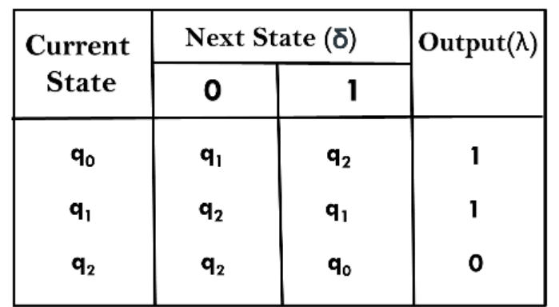
Draw the state diagram for the Moore Machine given below, qo is the start state

Slide 253
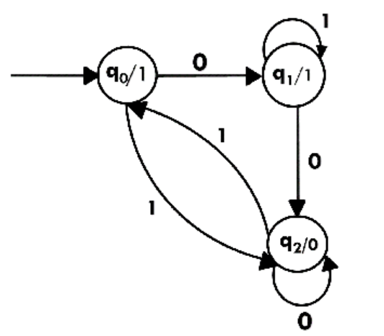
Draw the state diagram for the Moore Machine given below

Slide 254
Moore Machine-Example 1
Design Moore Machine to get 1’s complement of a given number
That means there are three states.
One state is start state.
The second state is for taking 0's as input and produces output as 1.
The third state is for taking 1's as input and producing output as 0.

Slide 255
Moore Machine-Example 1
Design Moore Machine to get 1’s complement of a given number

Slide 256
Moore Machine-Example 1
Design Moore Machine to get 1’s complement of a given number
States | 0 | 1
qo | q1 | q2
q1 | q1 | q2
q2 | q1 | q2
States | Δ/O
q0 | 0
q1 | 1
q2 | 0
0
q1/1
0
1
0
q0/0
q2/0
1
1

Slide 257
Construct a Moore machine that determines whether an input string contains an even or odd number of 1's. The machine should give 1 as output if an even number of 1's are in the string and 0 otherwise.
Moore Machine-Example 2

Slide 258
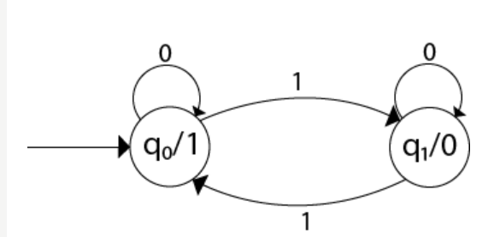
Construct a Moore machine that determines whether an input string contains an even or odd number of 1's. The machine should give 1 as output if an even number of 1's are in the string and 0 otherwise.
Moore Machine-Example 1
State q1 accepts an odd number of 1's
State q0 accepts even number of 1's.
There is no restriction on a number of zeros. Hence for 0 input, self-loop can be applied on both the states.

Slide 259
Moore Machine-Example 3
Design Moore Machine to find remainder after division by 3 for ∑={0,1}

Slide 260
Moore Machine-Example 2
Design Moore Machine to convert each occurrence of 100 by 101 over ∑={0,1}

Slide 261
Moore Machine-Example 2
Design Moore Machine to get 2’s complement of a given number

Slide 262
Moore Machine-Example 2
Design Moore Machine to convert each occurrence of 100 by 101 over ∑={0,1}
Strings=10100
100
100100
100000100
Skeleton-
0
1
q1/1
0
q2/0
q3/1
q0/0
1
0
1
1
0

Slide 263
Moore Machine-Example 2
Design Moore Machine to get 2’s complement of a given binary number
Steps-
Read the string bit by bit from LSB
Keep the bits unchanged till you get first ‘1’, Do not replace the first ‘1’ by ‘0’, Keep it unchanged
Remaining bits are changed from 0 to 1 and 1 to 0
Eg-
Binary Number 1 0 1 1 0
1’s Complement 0 1 0 0 1
+ 1
________________________
2’s Complement 0 1 0 1 0

Slide 264
Moore Machine-Example 2
Design Moore Machine to get 2’s complement of a given number
string “110”
Read from LSB
0
1
0
q1/1
0
q2/0
q0/0
1
1

Slide 265
Mealey Machine-Formal Definition
6 tuple representation
Moore Machine is denoted by 6 Tuple: M=(Q, ∑, Δ,δ, λ, q₀) where
Q:Finite set of states
∑:Finite input alphabet
Δ or O:Finite set of Output alphabet
δ:Q X ∑ ->Q State Transition function(STF)
Mapping State and input alphabet to the next state
λ:Q X ∑ ->Δ or O Machine Function/Output function
Mapping each state to the Output alphabet
q₀: Initial/Start state of FA, q0 ∈ Q

Slide 266
Mealey Machine-Formal Definition
Machine with finite number of states and for which the output symbol at a given time depends on the present input symbol as well as the present state of the machine

Slide 267
Mealey Machine-State Diagram
Draw the state diagram for the Mealey Machine given below:-
δ:Q X ∑ ->Q State Transition function(STF)
λ:Q X ∑ ->Δ or O Machine Function/Output function
 | Inputs
 | 0 |  | 1
States | Q | Δ | Q | Δ
q1 | q3 | 0 | q2 | 0
q2 | q1 | 1 | q4 | 0
q3 | q2 | 1 | q1 | 1
q4 | q4 | 1 | q3 | 0

Slide 268
Mealey Machine-State Diagram
Draw the state diagram for the Mealey Machine given below:-
 | Inputs
 | 0 |  | 1
States | Q | Δ | Q | Δ
q1 | q3 | 0 | q2 | 0
q2 | q1 | 1 | q4 | 0
q3 | q2 | 1 | q1 | 1
q4 | q4 | 1 | q3 | 0
Output is associated with the transition
q3
0/0
1/0
1/1
q4
0/1
q1
0/1
0/1
q2
1/0
1/0

Slide 269
Mealey Machine-State Diagram
In Mealey Machine, if the length of the input sequence is “n”, then the length of output is also “n”
Input=0101
Input=1100
O/P=??
q3
0/0
1/0
1/1
q4
0/1
q1
0/1
0/1
q2
1/0
1/0

Slide 270
Mealey Machine-State Diagram
In Mealey Machine, if the length of the input sequence is “n”, then the length of output is also “n”
Input=0101
O/P=0101
Input=1100
O/P=0011
q3
0/0
1/0
1/1
q4
0/1
q1
0/1
0/1
q2
1/0
1/0

Slide 271
Mealey Machine-Example 1
Design Mealey Machine that will read sequences made up of letters a,e,i,o,u and will give as o/p the same characters except when ‘i’ is followed by ‘e’ , it will be changed to ‘u’

Slide 272
Mealey Machine-Example 1
Design Mealey Machine that will read sequences made up of letters a,e,i,o,u and will give as o/p the same characters except when ‘I’ is followed by ‘e’ , ‘e’ will be changed to ‘u’
 | Inputs
 | a |  | e |  | i |  | o |  | u
States | Q | Δ | Q | Δ | Q | Δ | Q | Δ | Q | Δ
q1 | q0 | a | q0 | e | q1 | i | q0 | o | q0 | u
q2 | q0 | a | qo | u | q1 | i | q0 | o | q0 | u
a/a
e/e
o/o
u/u
i/i
q0
i/i
q1
e/u
a/a
o/o
u/u

Slide 273
Mealey Machine-Example 2
Design Mealey Machine to get 1’s complement of a given number

Slide 274
Mealey Machine-Example 2
Design Mealey Machine to get 1’s complement of a given number
Example-
 | Inputs
 | 0 |  | 1
States | Q | Δ | Q | Δ
q0 | q0 | 1 | q0 | 0
0/1
q0
1/0

Slide 275
Mealey Machine-Example 3
Design Mealey Machine to get 2’s complement of a given number

Slide 276
Mealey Machine-Example 3
Design Mealey Machine to get 2’s complement of a given number
1
0
q0/0
0
q1/1
1

Slide 277
Lecture 4.2.2022 Conversion of Mealy to Moore Machine Conversion of Moore to Mealy Machine

Slide 278
Conversion of Mealy Machine to Moore Machine

Slide 279
Conversion of Mealy Machine to Moore Machine-Eg1
 | Inputs
 | 0 |  | 1
States | Q | Δ | Q | Δ
q1 | q3 | 0 | q2 | 0
q2 | q1 | 1 | q4 | 0
q3 | q2 | 1 | q1 | 1
q4 | q4 | 1 | q3 | 0
Check Association-
We look into the next state column for any state say qi and determine the number of different outputs associated with qi in that column
We split qi into several different states,
The number of such states being equal to the number of different outputs associated with qi
Theory of Computer Science-KLP Mishra,N Chandrasekharan

Slide 280
Conversion of Mealy Machine to Moore Machine-Eg1
 | Inputs
 | 0 |  | 1
States | Q | Δ | Q | Δ
q1 | q3 | 0 | q2 | 0
q2 | q1 | 1 | q4 | 0
q3 | q2 | 1 | q1 | 1
q4 | q4 | 1 | q3 | 0
Theory of Computer Science-KLP Mishra,N Chandrasekharan

Slide 281
Conversion of Mealy Machine to Moore Machine-Eg1
 | Inputs
 | 0 |  | 1
States | Q | Δ | Q | Δ
q1 | q3 | 0 | q2 | 0
q2 | q1 | 1 | q4 | 0
q3 | q2 | 1 | q1 | 1
q4 | q4 | 1 | q3 | 0
Theory of Computer Science-KLP Mishra,N Chandrasekharan

Slide 282
Conversion of Mealy Machine to Moore Machine-Eg1
 | Inputs
 | 0 |  | 1
States | Q | Δ | Q | Δ
q1 | q3 | 0 | q2 | 0
q2 | q1 | 1 | q4 | 0
q3 | q2 | 1 | q1 | 1
q4 | q4 | 1 | q3 | 0
Theory of Computer Science-KLP Mishra,N Chandrasekharan

Slide 283
Conversion of Mealy Machine to Moore Machine-Eg1
 | Inputs
 | 0 |  | 1
States | Q | Δ | Q | Δ
q1 | q3 | 0 | q2 | 0
q2 | q1 | 1 | q4 | 0
q3 | q2 | 1 | q1 | 1
q4 | q4 | 1 | q3 | 0
Theory of Computer Science-KLP Mishra,N Chandrasekharan

Slide 284
Conversion of Mealy Machine to Moore Machine-Eg1
 | Inputs
 | 0 |  | 1
States | Q | Δ | Q | Δ
q1 | q3 | 0 | q2 | 0
q2 | q1 | 1 | q4 | 0
q3 | q2 | 1 | q1 | 1
q4 | q4 | 1 | q3 | 0
Theory of Computer Science-KLP Mishra,N Chandrasekharan

Slide 285
Conversion of Mealy Machine to Moore Machine-Eg1
 | Inputs
 | 0 |  | 1
States | Q | Δ | Q | Δ
q1 | q3 | 0 | q2 | 0
q2 | q1 | 1 | q4 | 0
q3 | q2 | 1 | q1 | 1
q4 | q4 | 1 | q3 | 0
q1 is associated with 1
q2 is associated with 0 and 1 both so split q2 into q20 and q21
q3 is associated with 0
q4 is associated with 0 and 1 both so split into q40 qnd q41
Theory of Computer Science-KLP Mishra,N Chandrasekharan

Slide 286
Conversion of Mealy Machine to Moore Machine-Eg1
 | Inputs
 | 0 |  | 1
States | Q | Δ | Q | Δ
q1 | q3 | 0 | q2 | 0
q2 | q1 | 1 | q4 | 0
q3 | q2 | 1 | q1 | 1
q4 | q4 | 1 | q3 | 0
Reconstruct the table
BY adding rows for each newly created state after splitting

Slide 287
Conversion of Mealy Machine to Moore Machine-Eg1
 | Inputs
 | 0 |  | 1
States | Q | Δ | Q | Δ
q1 | q3 | 0 | q20 | 0
q20 | q1 | 1 | q40 | 0
q21 | q1 | 1 | q40 | 0
q3 | q21 | 1 | q1 | 1
q40 | q41 | 1 | q3 | 0
q41 | q41 | 1 | q3 | 0
Reconstructed Table

Slide 288
Conversion of Mealy Machine to Moore Machine-Eg1
 | Inputs
 | 0 |  | 1
States | Q | Δ | Q | Δ
q1 | q3 | 0 | q20 | 0
q20 | q1 | 1 | q40 | 0
q21 | q1 | 1 | q40 | 0
q3 | q21 | 1 | q1 | 1
q40 | q41 | 1 | q3 | 0
q41 | q41 | 1 | q3 | 0
 | Inputs
 | a=0 | a=1 | Output
States | Q | Q | Δ
q1 | q3 | q20 | 1
q20 | q1 | q40 | 0
q21 | q1 | q40 | 1
q3 | q21 | q1 | 0
q40 | q41 | q3 | 0
q41 | q41 | q3 | 1
Rearrange the table
Pair of states and outputs in the next state column can be rearranged

Slide 289
Conversion of Mealy Machine to Moore Machine-Eg1
Initial state Check
q1 is the initial state & output is 1
If someone provides nothing to the FSM, O/P is 1 but this should not take place
So, we insert one more state say q0 which becomes the initial state with output=0 & the next state values of state q1 are copied in it also
Else if q1 was having O/P=0 then there was need of inserting any new state
 | Inputs
 | a=0 | a=1 | Output
States | Q | Q | Δ
q0 | q3 | q20 | 0
q1 | q3 | q20 | 1
q20 | q1 | q40 | 0
q21 | q1 | q40 | 1
q3 | q21 | q1 | 0
q40 | q41 | q3 | 0
q41 | q41 | q3 | 1

Slide 290
Conversion of Moore Machine to Mealy Machine

Slide 291
Conversion of Moore Machine to Mealy Machine-Eg1
 | Next state
States | a | b | Output
qo | q3 | q1 | 0
q1 | q1 | q2 | 1
q2 | q2 | q3 | 0
q3 | q3 | q0 | 0
Theory of Computer Science-KLP Mishra,N Chandrasekharan

Slide 292
Conversion of Moore Machine to Mealy Machine-Eg1
 | Next state
States | a | b | Output
qo | q3 | q1 | 0
q1 | q1 | q2 | 1
q2 | q2 | q3 | 0
q3 | q3 | q0 | 0
Reconstruct the Table
For every input symbol, we form the pair consisting of the next state and the corresponding output and reconstruct the table for Mealy Machine
Check present state q3 is associated with which output? i.e. 0
Check present state q1 is associated with which output? i.e.
Theory of Computer Science-KLP Mishra,N Chandrasekharan

Slide 293
Conversion of Moore Machine to Mealy Machine-Eg1
 | Next state
 | a=0 |  | a=1
Present States | State | Output | State | Output
qo | q3 | 0 | q1 | 1
q1 | q1 | 1 | q2 | 0
q2 | q2 | 0 | q3 | 0
q3 | q3 | 0 | q0 | 0
Identical transition check
We reduce the number of states in any model by considering states with identical transitions.
If two states have identical transitions then we can delete one of them
Theory of Computer Science-KLP Mishra,N Chandrasekharan

Slide 294
Conversion of Moore Machine to Mealy Machine-Eg2
 | Next state
States | a | b | Output
q1 | q1 | q2 | 0
q2 | q1 | q3 | 0
q3 | q1 | q3 | 1
Consider the Moore Machine described by the transition table given. Construct the corresponding Mealy Machine

Slide 295
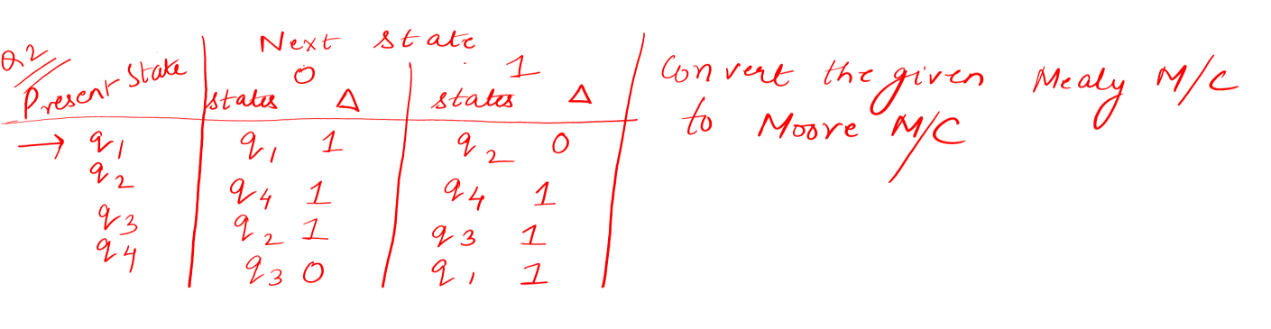

Slide 296
Regular Expression
Now, we switch our attention from machine like descriptions of languages i.e. Deterministic and nondeterministic finite automata to an algebraic description-”The regular expression”
We shall find that regular expressions can define exactly the same languages that the various forms of automata describe i.e. The regular languages

Slide 297
Regular Expression
However, regular expressions offer something that automata do not: a declarative way to express the strings we want to accept.
Thus, regular expressions serve as the input language for many systems that process strings.

Slide 298
Regular Expression
Eg- The RE=01*+10*
Denotes the language consisting of all strings that are either a single 0 followed by any number of 1’s or a single 1 followed by an number of 0’s

Slide 299
Regular Expression
Language defining notation
Can be thought of as a “programming language’ in which we express some important applications such as text search algorithm or compiler components

Slide 300
Regular Expression
Regular Expression are closely related to nondeterministic finite automata
Can be thought of as a “User friendly” alternative to the NFA notation for describing software components

Slide 301

Regular Expression
RE Denote Languages
RE are capable of defining all and only the regular languages

Slide 302

Chomsky Hierarchy in Theory of Computation
Chomsky Hierarchy represents the class of languages that are accepted by the different machine.
The category of language in Chomsky's Hierarchy is as given below:
Type 0 known as Unrestricted Grammar.
Type 1 known as Context Sensitive Grammar.
Type 2 known as Context Free Grammar.
Type 3 Regular Grammar.

Slide 303
Chomsky Hierarchy in Theory of Computation
Type 3 Grammar:
Type 3 Grammar is known as Regular Grammar.
Regular languages are those languages which can be described using regular expressions.
These languages can be modelled by NFA or DFA.

Slide 304
Chomsky Hierarchy in Theory of Computation
This is a hierarchy.
Therefore every language of type 3 is also of type 2, 1 and 0.
Similarly, every language of type 2 is also of type 1 and type 0, etc.

Slide 305
Operators of Regular Expression
We have to learn the three operations that the operators of regular expressions represent.
These operations are:-
Union
Concatenation
Kleene Closure

Slide 306
Operators of Regular Expression
UNION-
The union of two languages L and M
Denoted as L U M
The set of strings that are in either L or M or both
Eg-
If L ={001,10,111} and M={ε,001} then
L U M={ε,10,001,111}

Slide 307
Operators of Regular Expression
Concatenation-
The concatenation of languages L and M
The set of strings that can be formed by taking any string in L and concatenating it with any string in M
Denoted with a dot or with no operator at all, although the concatenation operator is frequently called dot.
Eg-
If L={001,10,111} and M={ε,001} then L.M or just LM is {001,10,111,001001,10001,111001}

Slide 308
Operators of Regular Expression
Kleene Closure-
The closure or star or Kleene closure of a language L
Denoted by L*
Represents the set of those strings that can be formed by taking any number of strings from L, possibly with repetitions (i.e. the same string may be selected more than once) and concatenating all of them.

Slide 309
Operators of Regular Expression
Kleene Closure-
Eg-
If L={0,1} then L* is all strings of 0’s and 1’s
If L ={0,11} then L* consists of those strings of 0’s and 1’s such that the 1’s come in pairs E.g. 011, 11110 but not 01011 or 101

Slide 310
Operators of Regular Expression
Kleene Closure-
Star Operation
Bit different from the other two operations because it applies to a single language rather than two
Works by attaching any number of strings in A together to get a string in the new language
As “Any number” includes 0 as a possibility, the empty string ε is always a member of A*
Iteration of strings

Slide 311
Eg
Let the alphabet ∑ be the standard 26 letters {a,b,….z}
If A={good,bad} and B={boy,girl} then find out-
AUB
A.B
A*

Slide 312
Eg
Let the alphabet ∑ be the standard 26 letters {a,b,….z}
If A={good,bad} and B={boy,girl} then
AUB={good,bad,boy,girl}
A.B={goodboy,goodgirl,badboy,badgirl}
A*={ε,good,bad,goodgood,badbad,goodbad,badgood,goodgoodgood,badbadbad,goodgoodbad,goodbadgood,badgoodgood,goodbadbad,badgoodbad,badbadgood,……………………………….}

Slide 313
Building Regular Expressions
Formal Recursive Definition of Regular Expression over ∑ as follows-
1. Any terminal symbol (i.e. an element of ∑), Λ and ∅ are regular
expressions. When we view a in ∑ as a regular expression, we denote it by a.
2. The union of two regular expressions R1 and R2 , written as R1 + R2, is also a regular expression.
3. The concatenation of two regular expressions R1and R2, written as
R1R2, is also a regular expression.
4. The iteration (or closure) of a regular expression R written as R*, is
also a regular expression.
5.If R is a regular expression, then (R) is also a regular expression.
6. The regular expressions over∑ are precisely those obtained
recursively by the application of the rules 1-5 once or several times

Slide 314
Scrutiny of Rules
We use ‘x’ for a regular expression just to distinguish it from the symbol or string x.
The paranthesis used in Rule 5 influence the order of evaluation of a regular expression
In the absence of paranthesis, the Hierarchy is as follows:-
Iteration(closure),concatenation and union
The hierarchy is similar to that followed for arithmetic expressions (exponentiation, multiplication and addition)

Slide 315
BASIS
The basis consists of three parts:
The constants ε and ∅ are regular expressions, denoting the languages {ε} and ∅ respectively. That is, L(ε )={ε } and L(∅)= ∅
If a is any symbol, then a is a regular expression. This expression denotes the language {a}. That is, L(a)={a}, Note that we use boldface font to denote an expression corresponding to a symbol.

Slide 316
Definitions
Any set represented by a regular expression is called a regular set.
If for example, a, b ε ∑. Then
(i) a denotes the set {a},
(ii) a + b denotes {a, b},
(iii) ab denotes {ab},
(iv) a* denotes the set {ε. a, aa. aaa, ... } and
(v) (a + b)* denotes {a, b}*. The set represented by R is denoted by L(R),
Notes:
Definitions

Slide 317
Questions
Q1) Describe the following sets by regular expressions:
{101}
{abba}
{01,10}
{Λ ,ab}
{abb, a, b, bba}
{Λ , 0, 00, 000.... }
{1, 11, 111 ... }

Slide 318
Solution
(a) Now. {1}. {O} are represented by 1 and O. respectively. 101 is obtained
by concatenating 1,0 and 1 So. {101} is represented by 101.
(b) {abba} is represented by abba
(c) As {01, 10} is the union of {01} and {10}, we have {01, 10}
represented by 01 + 10
(d) The set {Λ , ab} is represented by Λ + ab
(e) The set {abb, a, b, bba} is represented by abb + a + b + bba.
f) As {Λ , 0, 00, 000, ... } is simply {0}*. it is represented by 0*
(g) Any element in {1, 11, 111, ... } can be obtained by concatenating
1 and any element of {1}*. Hence 1(1)* =1⁺ represents {1, 11, 111, ... }

Slide 319
Examples-
(ab)² = abab ǂa² b² , so don't try to use "algebra”.
(a+b)² = (a+b)(a+b) = aa or ab or ba or bb.
(a+b)* any string made up of a’s and b’s.

Slide 320
Examples-
(ab)² = abab ǂa² b² , so don't try to use "algebra”.
(a+b)² = (a+b)(a+b) = aa or ab or ba or bb.
(a+b)* any string made up of a’s and b’s.

Slide 321

Question 2-Beginning and Ending……

Slide 322
Question 2-Beginning and Ending……

Slide 323

Solution

Slide 324
Questions
Q3) Let S={a,b}, find S*,S+
Q4) What is a.a*?
Q5) What is (a*)*?
Q6) Find (a.b)* and (b.a)*
Q7) Represent {a,b} as a regular expression

Slide 325
Questions
Q3) Let S={a,b}, find S*,S+
Q4) What is a.a*?
Q5) What is (a*)*?
Q6) Find (a.b)* and (b.a)*
Q7) Represent {a,b} as a regular expression

Slide 326
Solution
Q3) Let S={a,b}, find S*,S+
S*={ε,a,b,aa,bb,ab,ba,……}
S⁺={a,b,aa,bb,ab,ba,……..}
Q4) What is a.a*?
a.a*=a⁺=a*.a={a,aa,aaa,….}
Q5) What is (a*)*?
(a*)*= a*
Q6) Find (a.b)* and (b.a)*
(a.b)*={ε,ab,abab,ababab,…..}
(b.a)*={ε,ba,baba,bababa,…..}
Q7) Represent {a,b} as a regular expression
a+b

Slide 327
Questions-Begins and Ends….
Q8) Represent the Following with the help of RE-
a) All strings that begin with a and end with b
b) The set of all strings with alphabet set ∑={a,b} such that each word begins and ends with “a”

Slide 328
Solution-Begins and Ends….
Q8) Represent the Following with the help of RE-
a) All strings that begin with a and end with b
a (a + b)* b
b) Represent the set of strings with alphabet set ∑={a,b} such that each word begins and ends with “a”
a+a(a+b)*a

Slide 329
Questions-Exactly, At the most….
Q9) Represent the following set of strings as regular expressions
Each word has exactly one “a” over ∑={a,b}
Set of all strings with at the most 2 zeros over ∑={0,1}
All words that contain exactly 2b’s or exactly 3b’s
No of occurrences of “a” is divisible by 3 with ∑={a,b,c}

Slide 330
Solution-Exactly, At the most….
Q9) Represent the following set of strings as regular expressions
a) Each word has exactly one “a” over ∑={a,b}
b*ab*
b) Set of all strings with at the most 2 zeros over ∑={0,1}
1*+1*01*+1*01*01*
c) All words that contain exactly 2b’s or exactly 3b’s over ∑={a,b}
a*ba*ba*+a*ba*ba*ba*
d) No of occurrences of “a” is divisible by 3 with ∑={a,b,c}
( (b+c)*a(b+c)*a(b+c)*a(b+c)* )*+(b+c)*

Slide 331
Solution-Exactly, At the most….
Q9) Represent the following set of strings as regular expressions
a) Each word has exactly one “a” over ∑={a,b}
b*ab*
b) Set of all strings with at the most 2 zeros over ∑={0,1}
1*+1*01*+1*01*01*
c) All words that contain exactly 2b’s or exactly 3b’s over ∑={a,b}
a*ba*ba*+a*ba*ba*ba*
d) No of occurrences of “a” is divisible by 3 with ∑={a,b,c}
( (b+c)*a(b+c)*a(b+c)*a(b+c)* )*+(b+c)*

